Slide 1


Global Cancer Data Visualization April 2021
Project team 2
Abhusan Karki, Ahmed Mohamed, Mona Peteet, Stephen Domke

Slide 2
Global Cancer Data Viz project - proposal
Project scope: This data analysis project provides insights into global cancer statistics via a dashboard of visualizations available through an HTML site. Visitors to the site can view the entire dataset (World) or select a specific country to investigate. Various data points will be presented (e.g., cancer rates, types, age)
Technical scope: ETL via Python, Flask for rendering API and JSON data for Plotly charts/graphs, HTML and CSS will be used to create the site.
A previously unused JS Library will be used in the application (options to be explored; (e.g. slick)
Datasource: https://ourworldindata.org/cancer

Slide 3
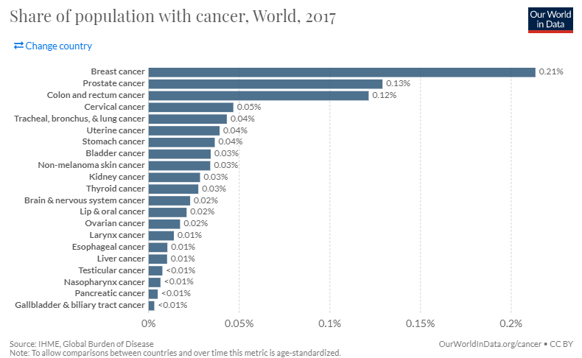

Slide 4
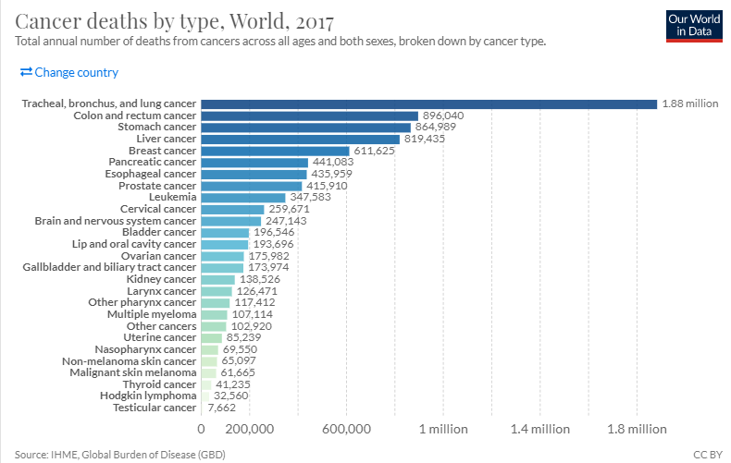

Slide 5
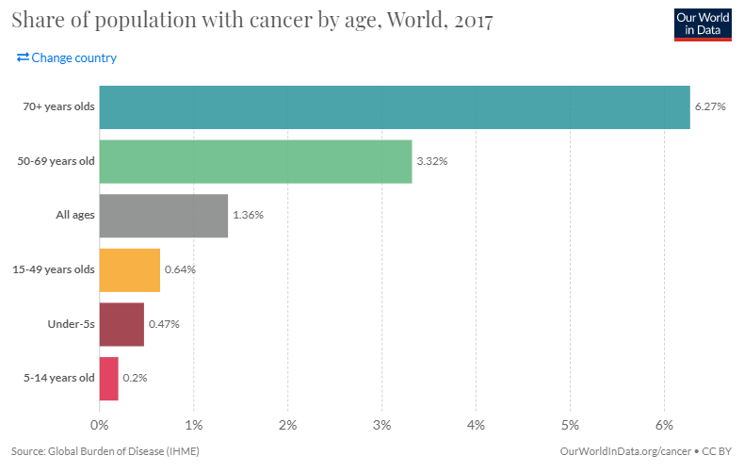

Slide 6
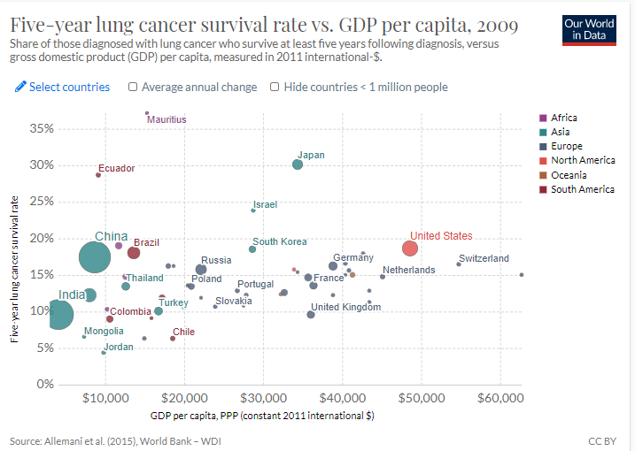

Slide 7
Plan
Download data
Create Flask app
a. In pandas pull in the data files
b. save as python
c. convert them to JSON

